Slide 1

Project Presentation
Real-Time Safety
Monitoring System
2025.05.26
MEERKAT

Slide 2
Our Team
Meet our Team Members
ALIBOEV
ABBOS
김태영
전설민
Team Leader
AI, Frontend
AI, Backend
Backend, DB

Slide 3
Table of
Contents
01
Project Idea, Motivation
02
Requirement Analysis
03
Tools, System Design
04
UI, Website Features
05
AI Integration (YOLO)
06
Progress, Future Plans

Slide 4
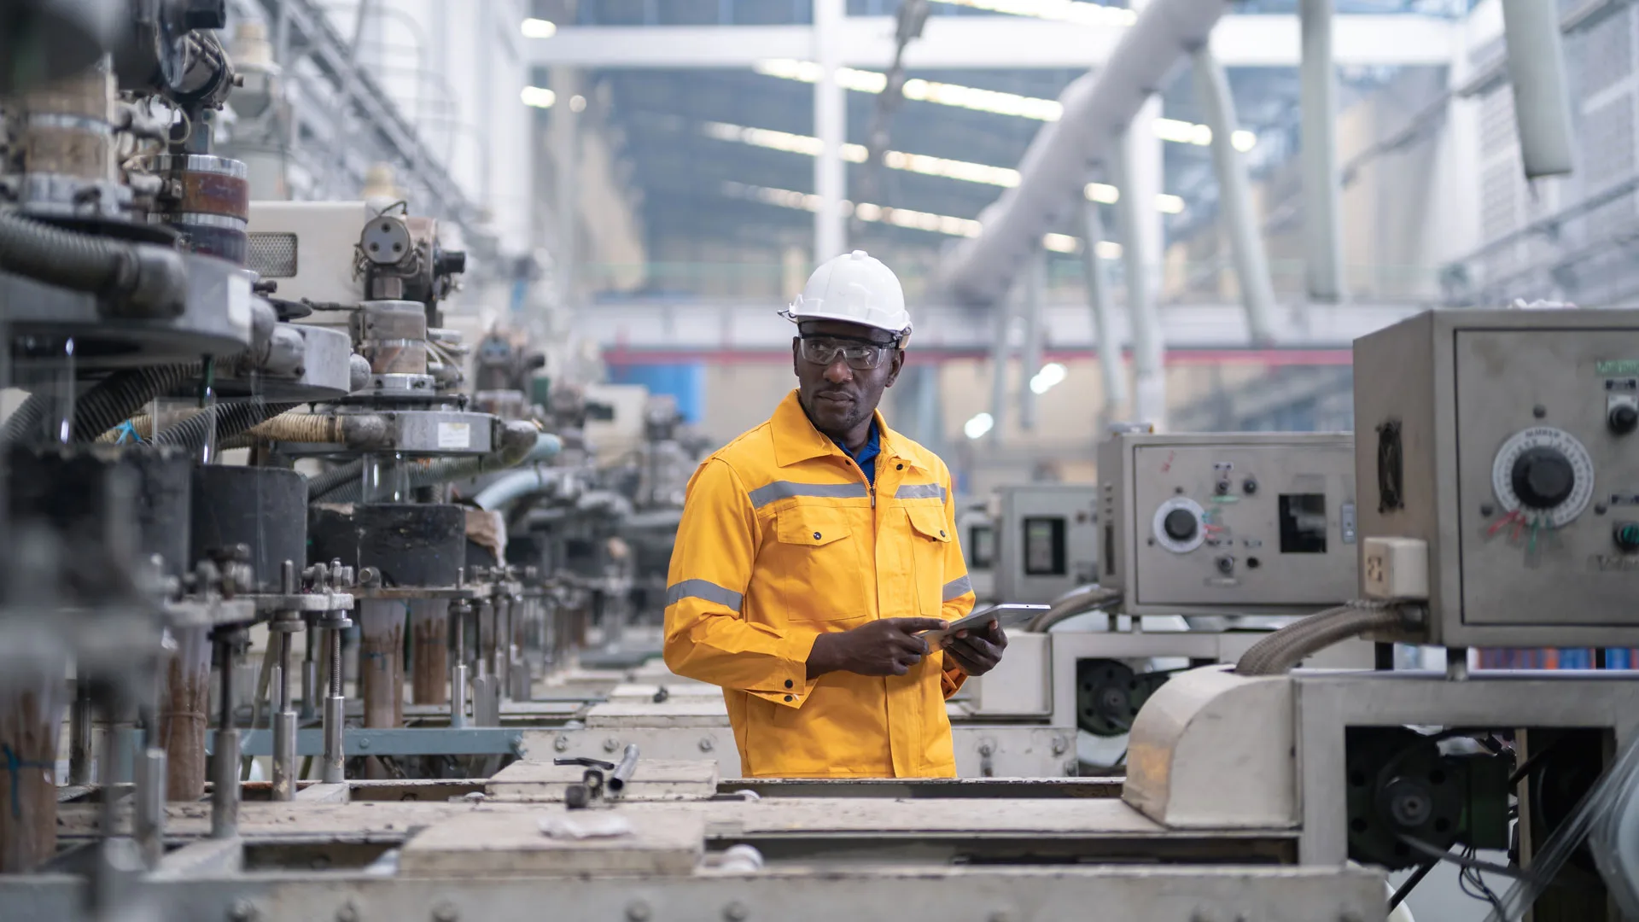



Why Safety Monitoring ?
We chose this project because safety is very important in many workplaces like factories and construction sites.
Automation is
everywhere
Companies want
smart safety systems
PPE is important for workers

Slide 5
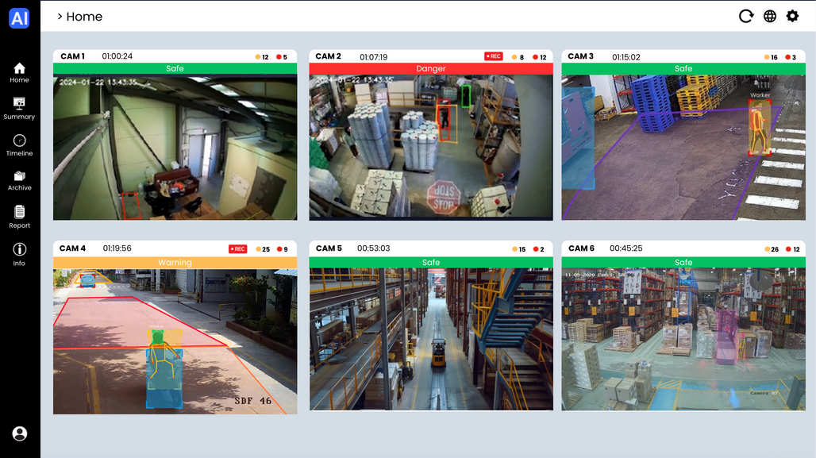
Our Solution
01
We created a website for
safety monitoring
02
It works in real time
03
It is easy to use and web-based

Slide 6


We Added AI !
+
=
Website was the task
But we added AI (YOLO)
to make it smart
Now it can detect PPE automatically.

Slide 7







Tools & Technologies
Design
Frontend
Backend
AI

Slide 8




Functional Requirements
& System Architecture
How it Works ?
Show live camera feeds
on the dashboard
Detect PPE in real time
(AI - YOLO)
Save detection data to the database
Show safety summary and detailed reports

Slide 9



Non-Functional Requirements
System Quality Goals
Fast response
Easy to use
Mobile-friendly

Slide 10
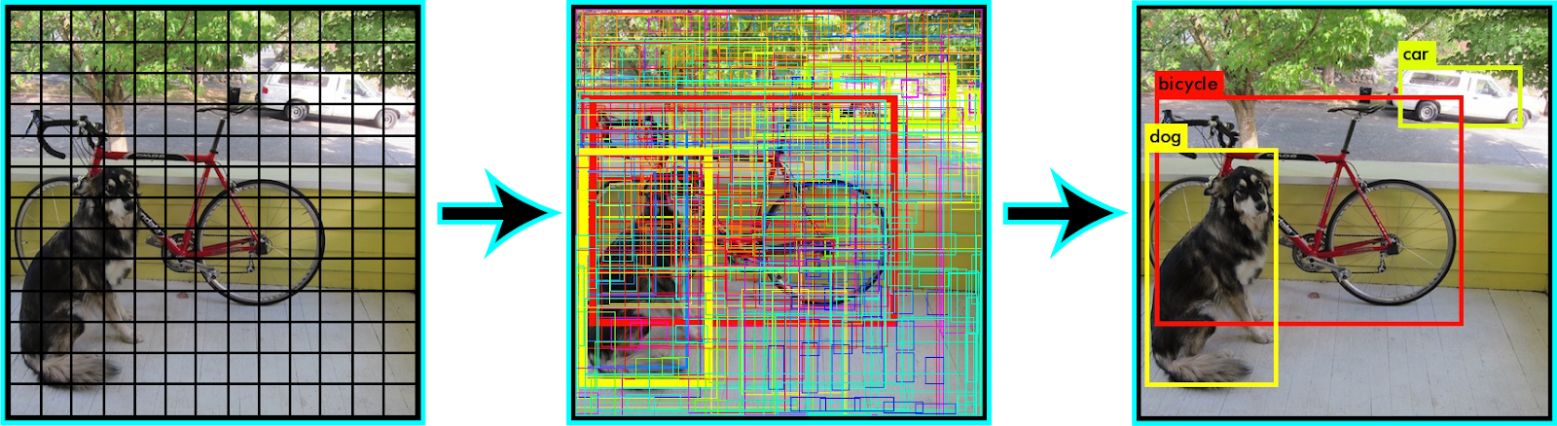
AI Model
How YOLO Works:
YOLO - You Only Look Once

Slide 11
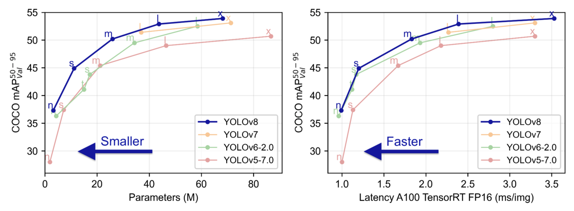

AI Model
Why YOLOv8n ?
Fast
Accurate
Lightweight

Slide 12

Website Overview
Pages of Our Website
01
Login
05
Timeline
02
Home (Dashboard)
06
Report
03
Camera Detail
07
Info
04
Summary
08
Settings
Let’s see the UI details

Slide 13
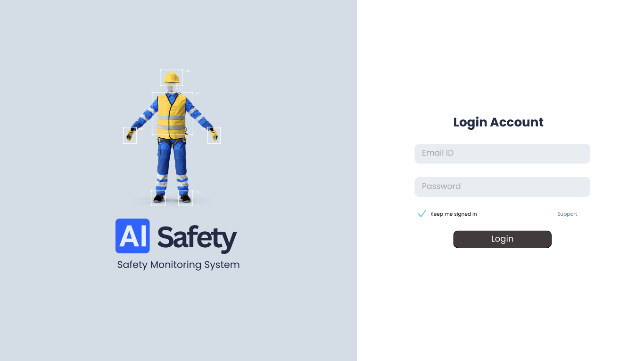
Login Page
INFO ABOUT SYSTEM
LOGIN FORM

Slide 14
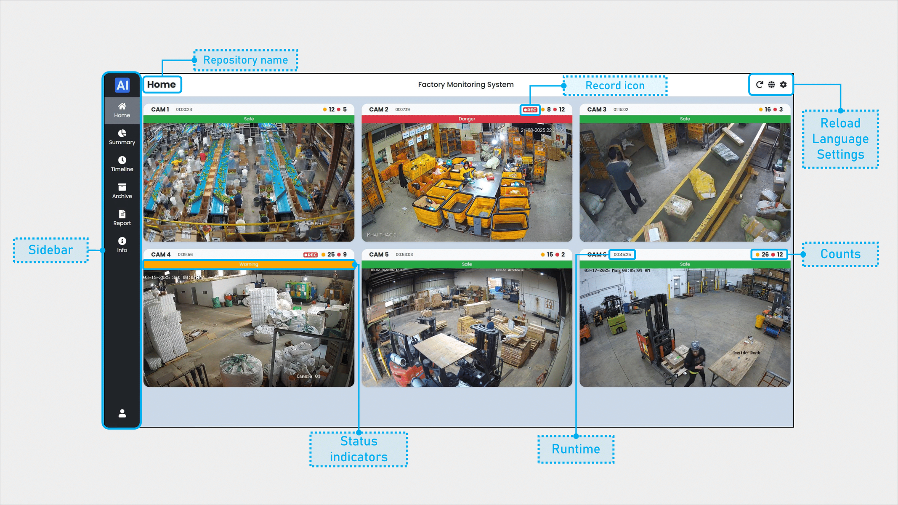
Dashboard Page (Home)

Slide 15
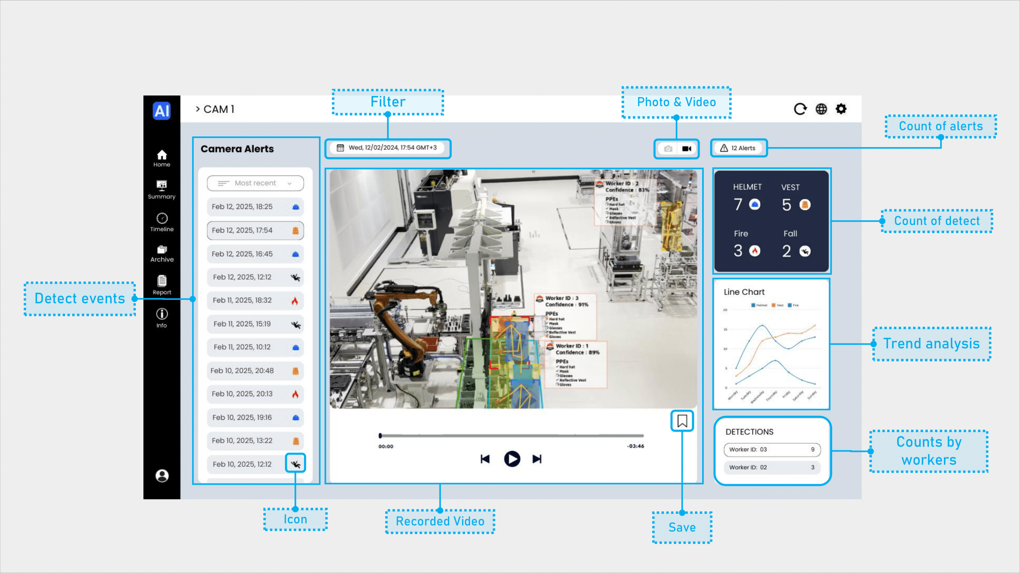
Camera Detail Page

Slide 16
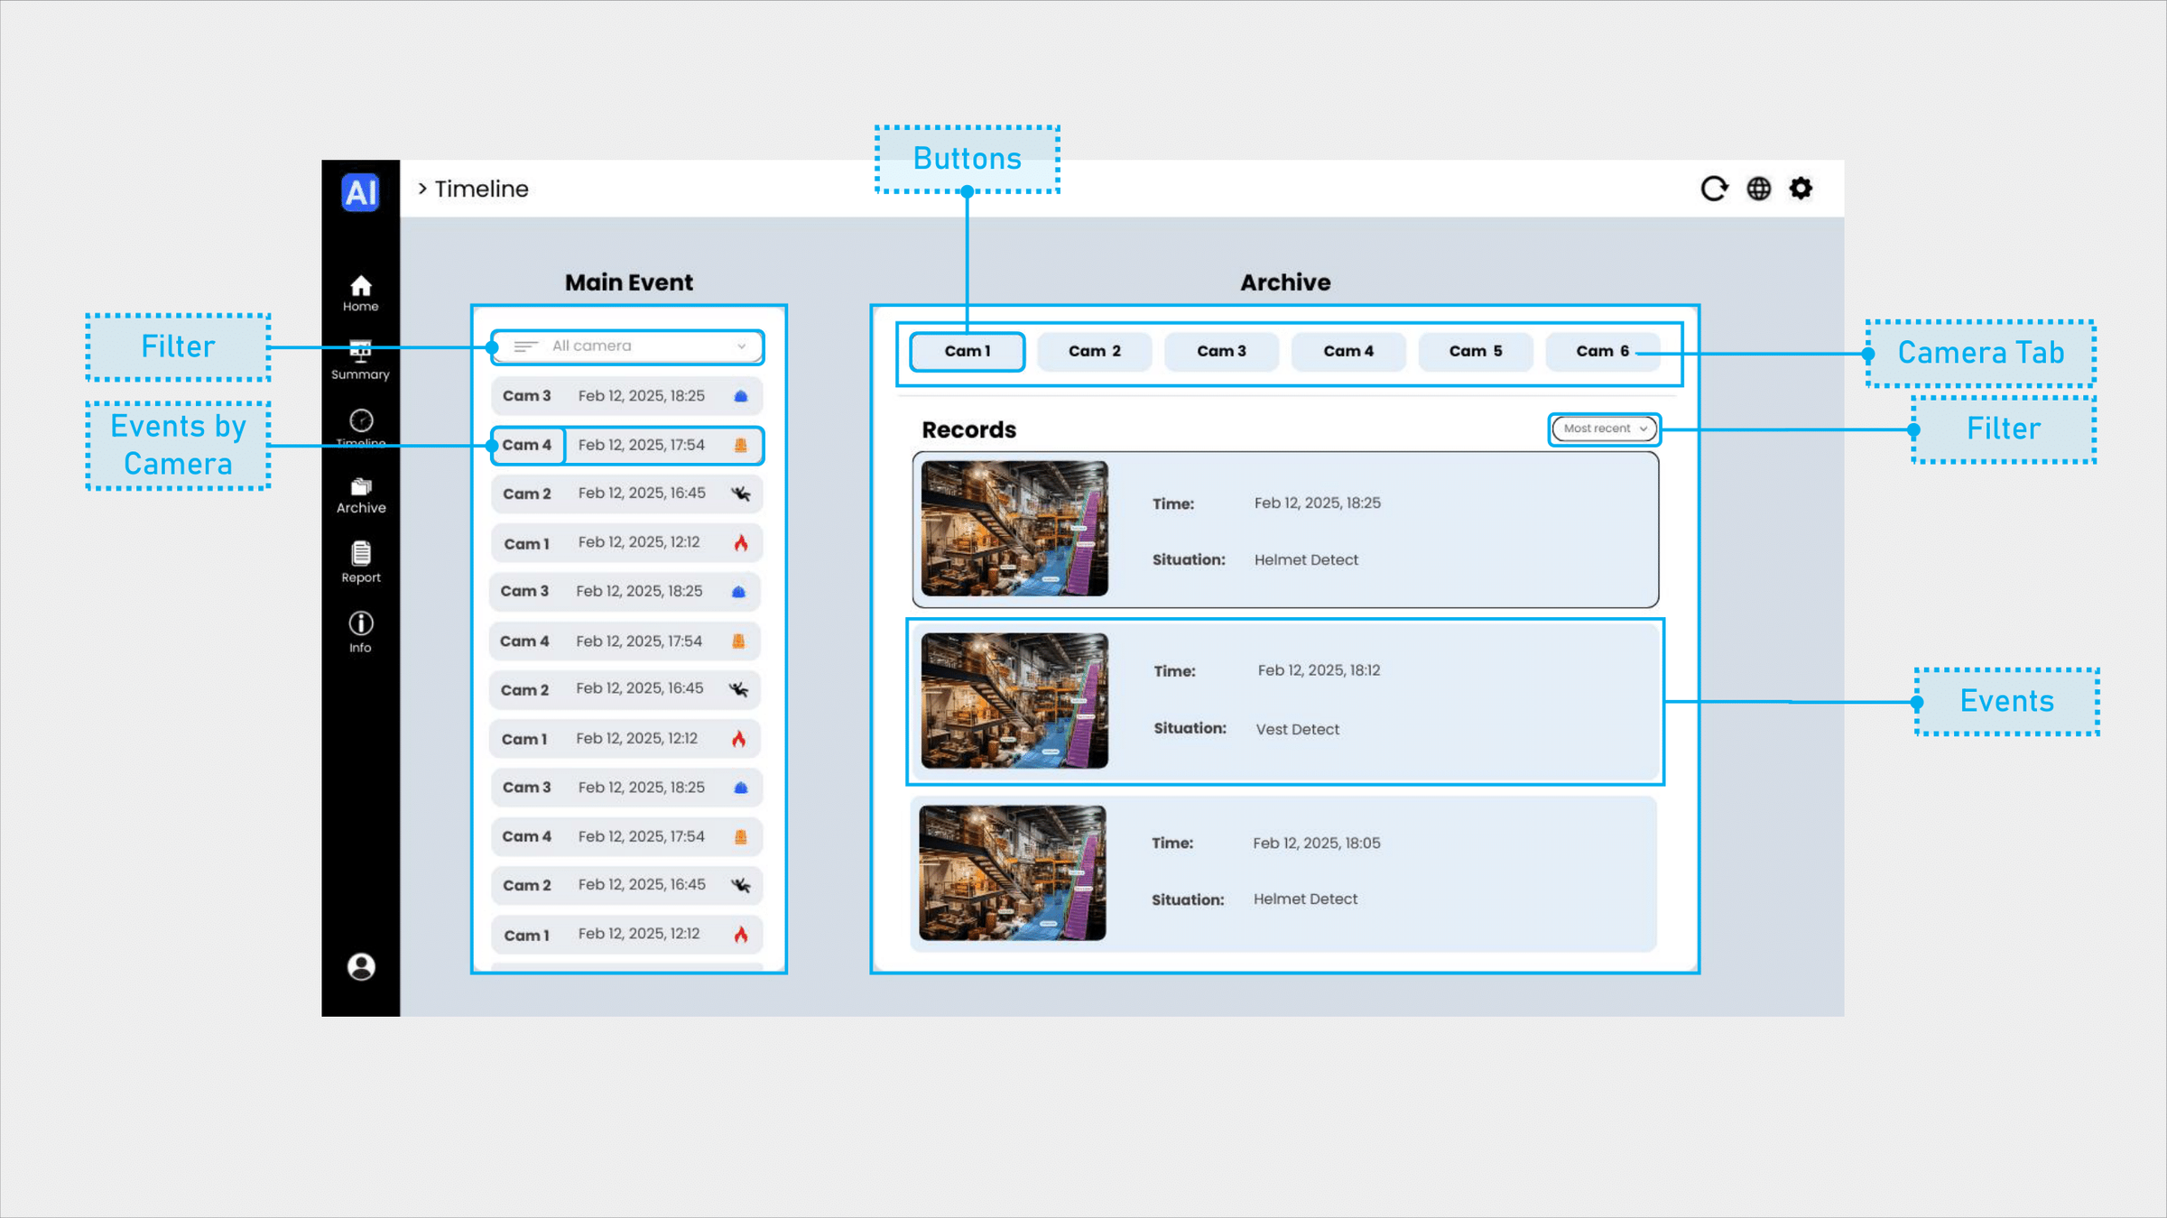
Timeline Page

Slide 17
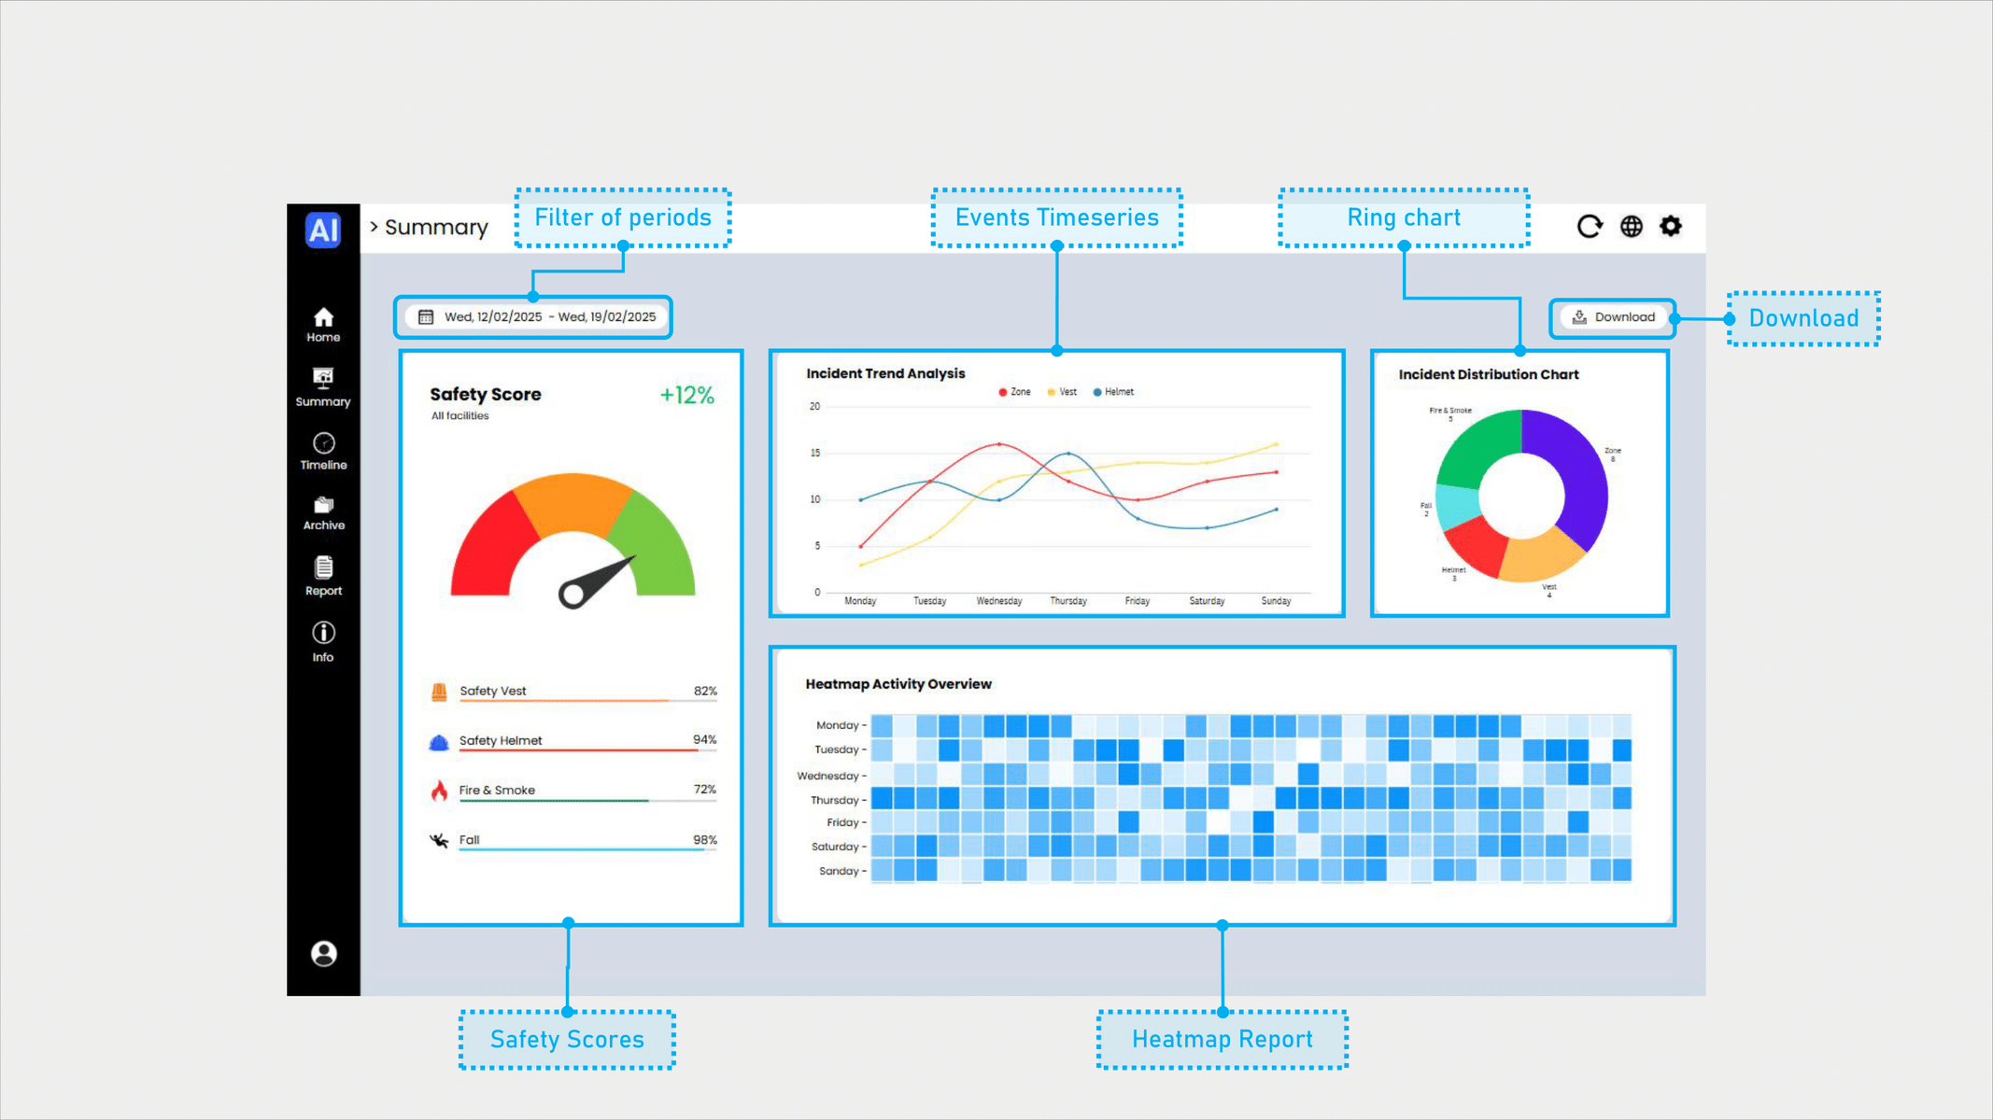
Summary Page

Slide 18
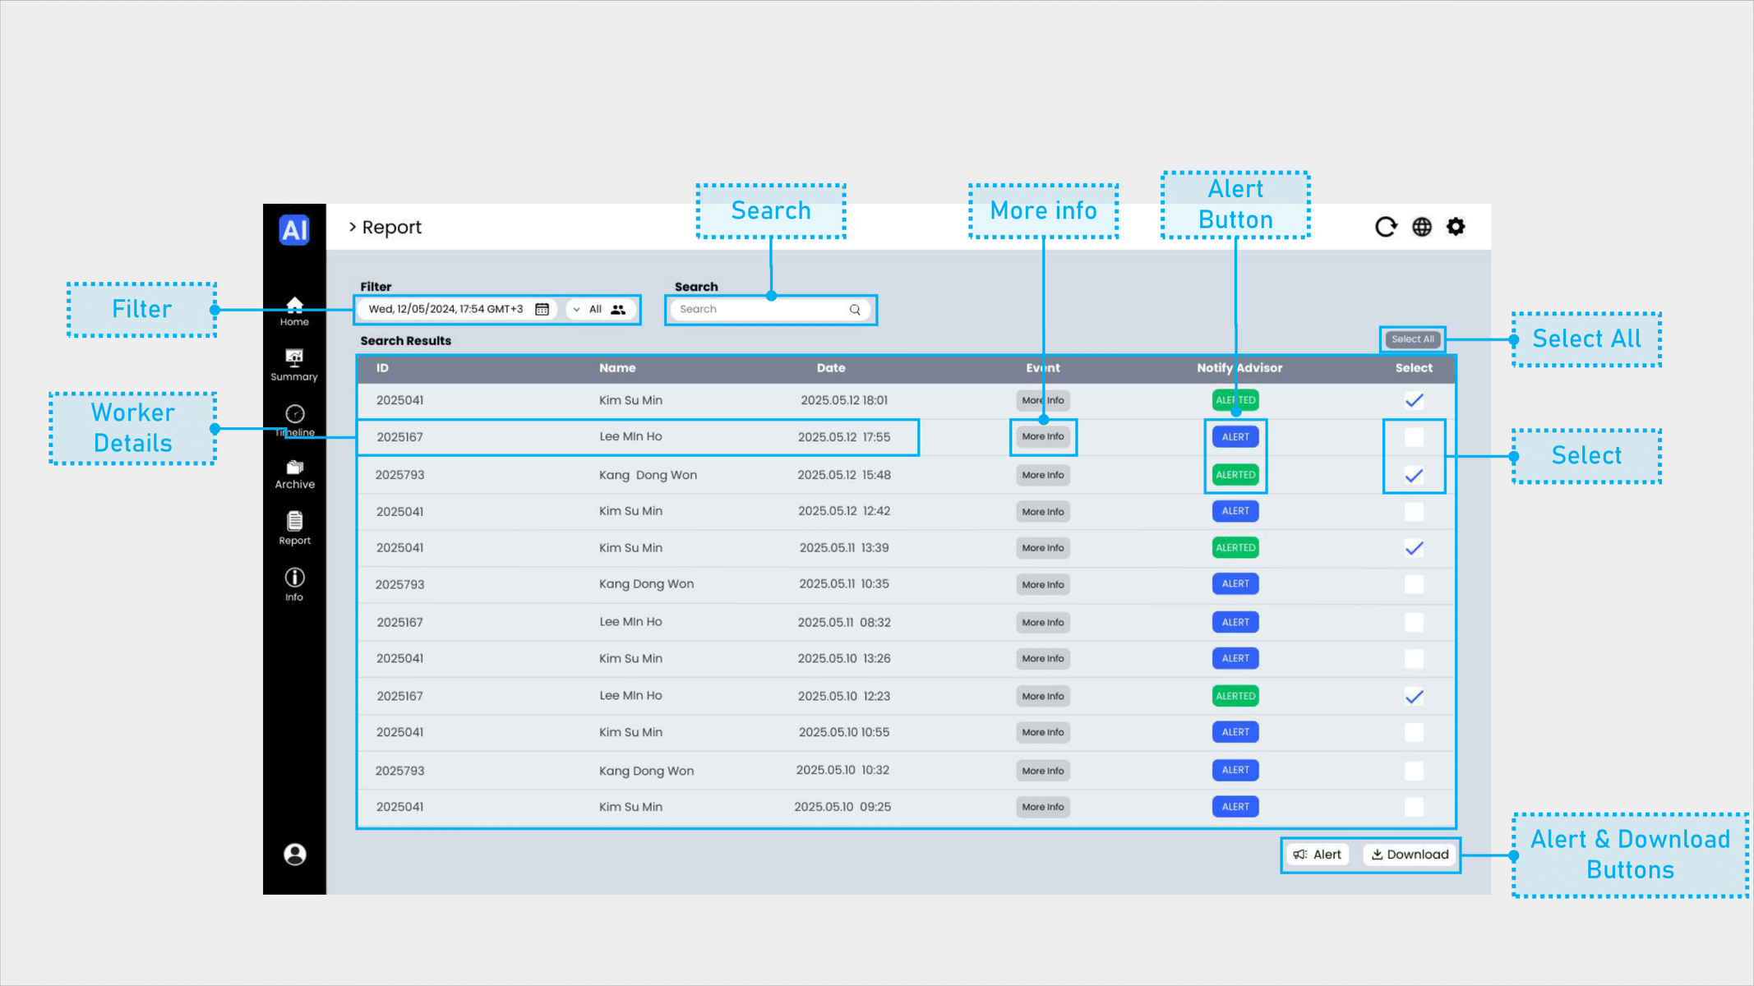
Report Page

Slide 19
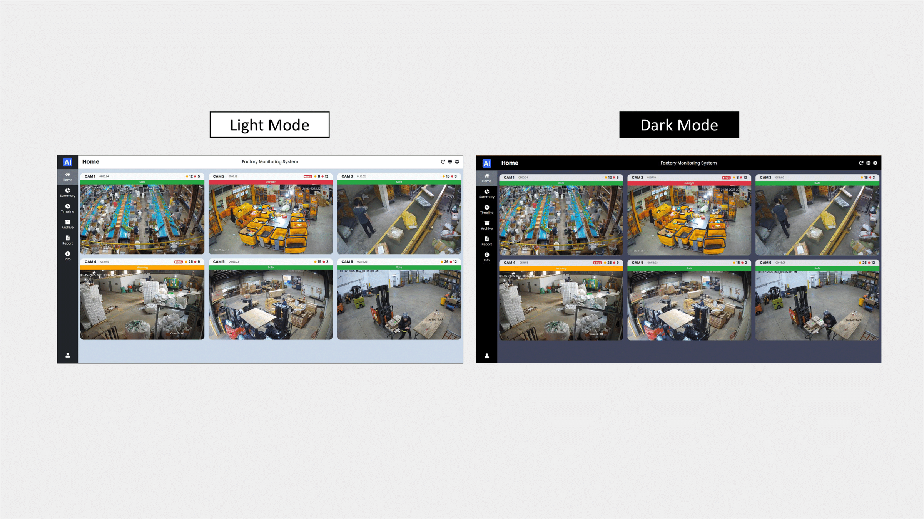
Dark and Light Mode

Slide 20
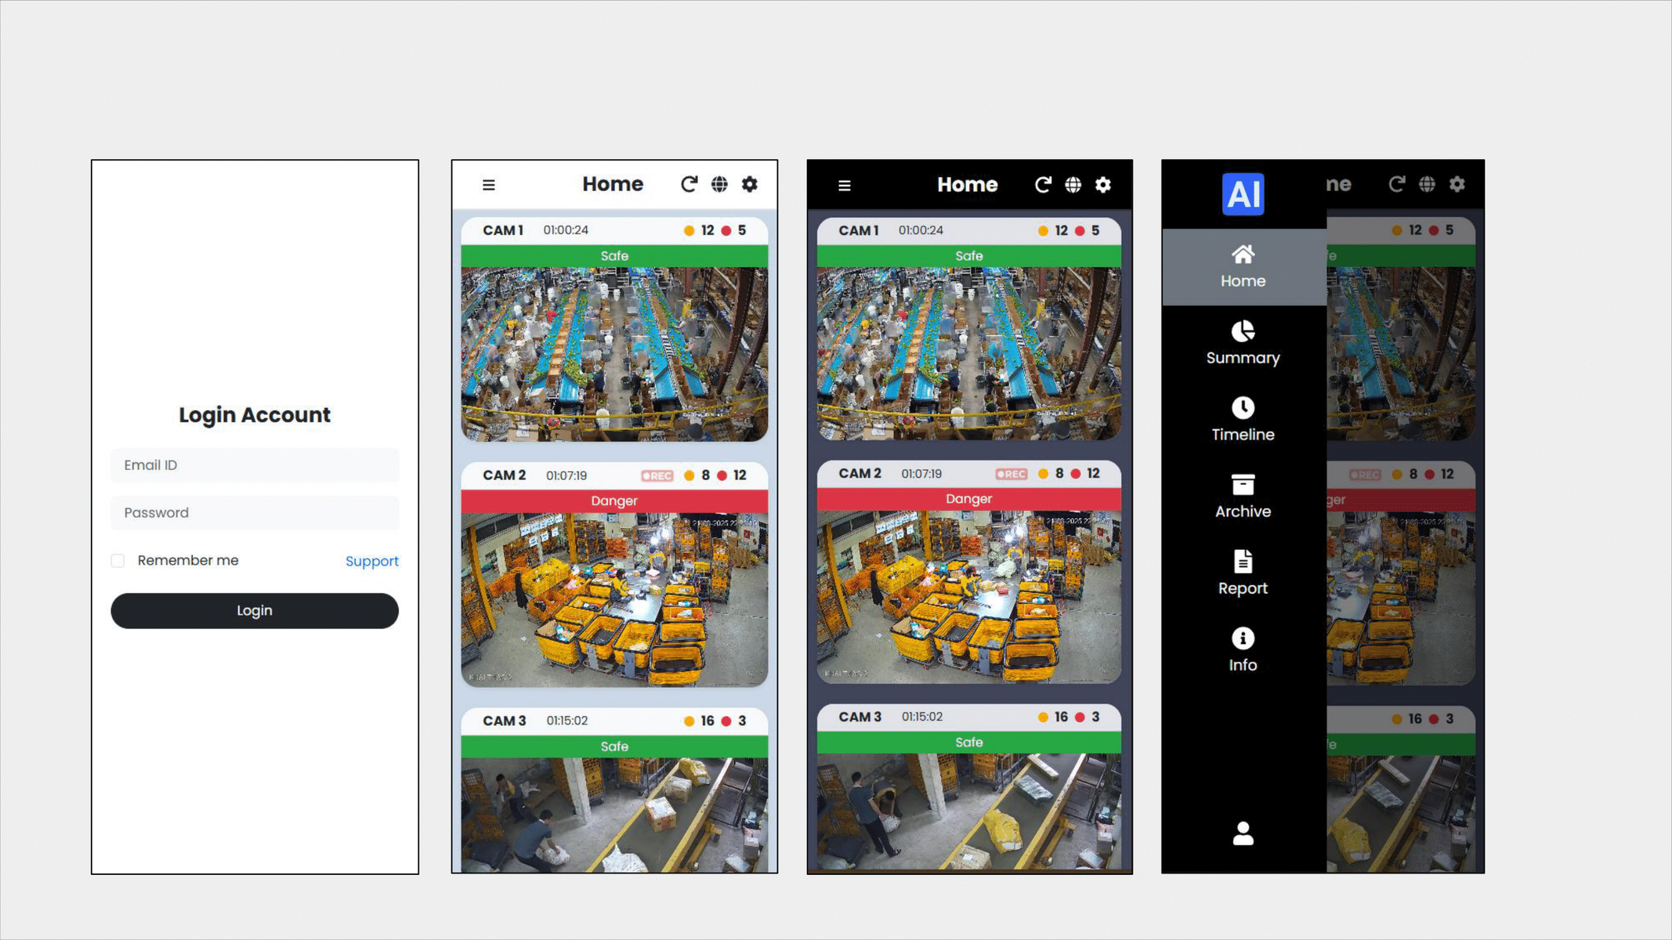
Responsive Design
Mobile

Slide 21

Our Progress
Task
30%
60%
Completed
UI Design
Frontend
Backend
AI Dataset
YOLO Training
Full System Integration

Slide 22

Future Plans
Our Future Plans:
Add More AI modules
(Safety Glass, etc)
Create settings page
Optimize system speed

Slide 23
Thank You
Q & A
MEERKAT

